Slide 1
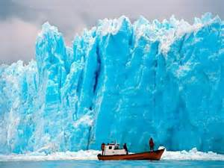
Glaciers
By: Adrene Gray

Slide 2
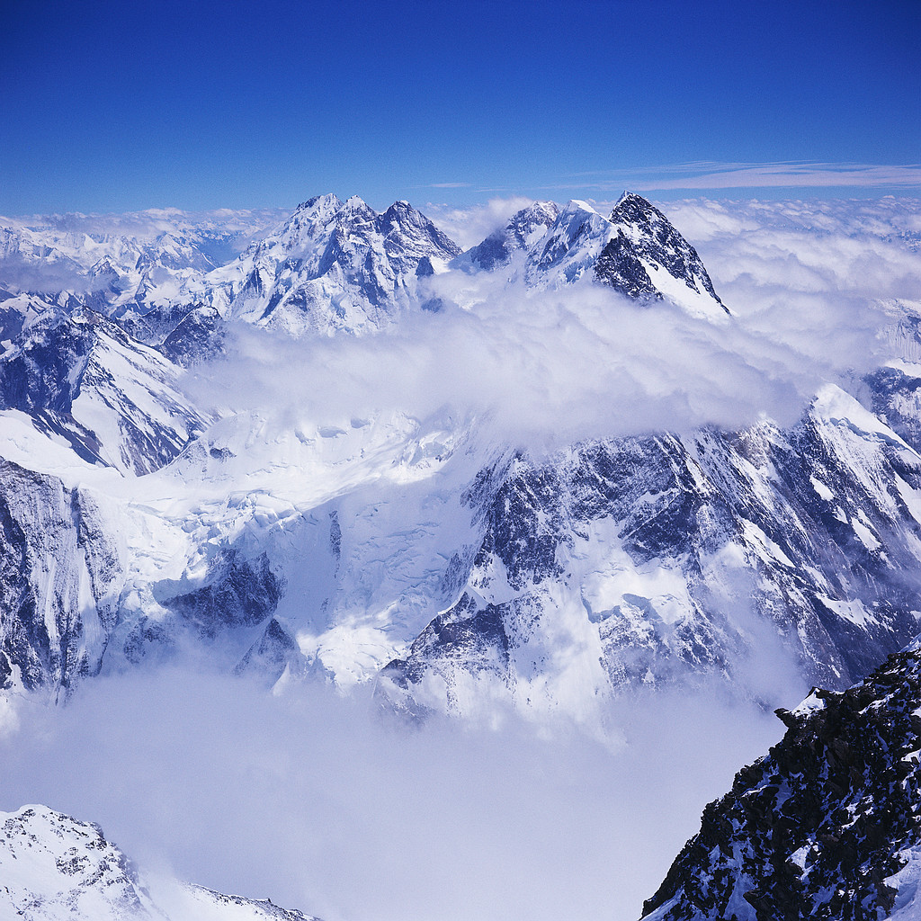
GLACIERS
75%of the Earth fresh water is in the form of Glaciers
Glaciers have ice on top of Mountains just any kind of ice rocks mixed ice.

Slide 3
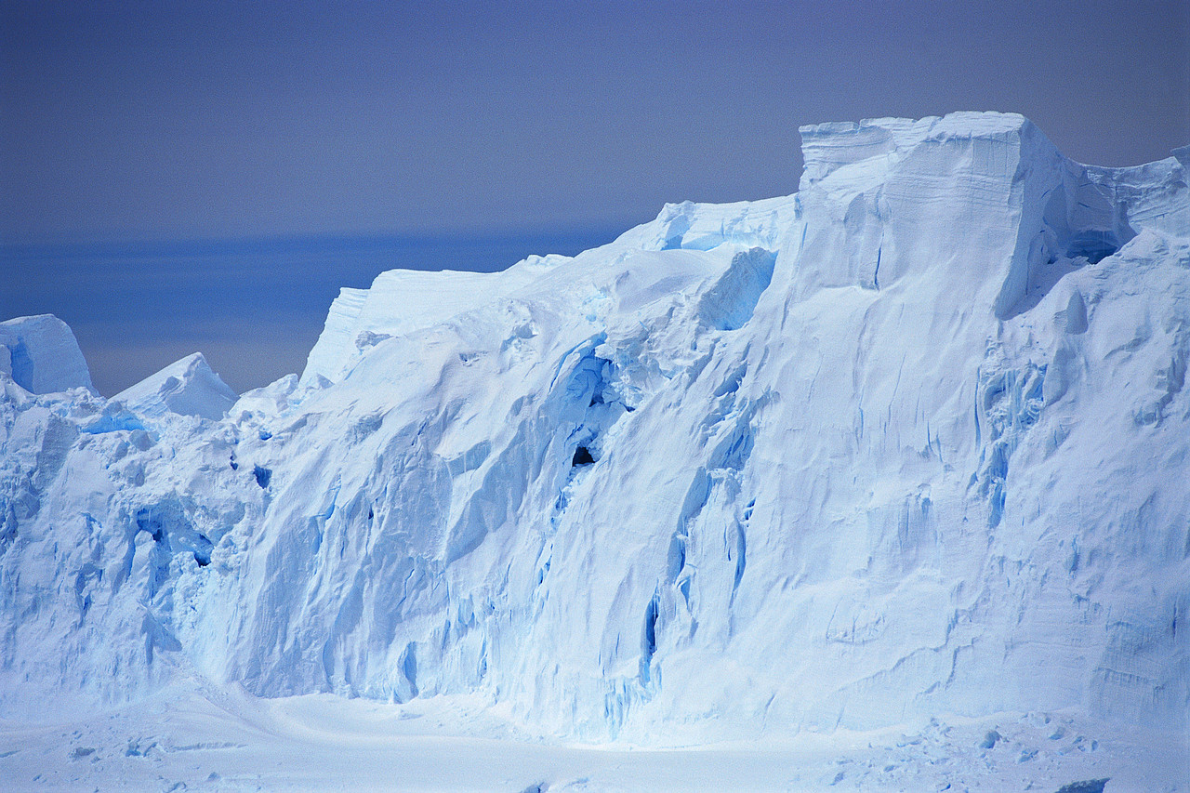
Glaciers
Glaciers are large ice mountains its 75% of earth water so that I think that there is 25% of earths water that is a liquid water.

Slide 4
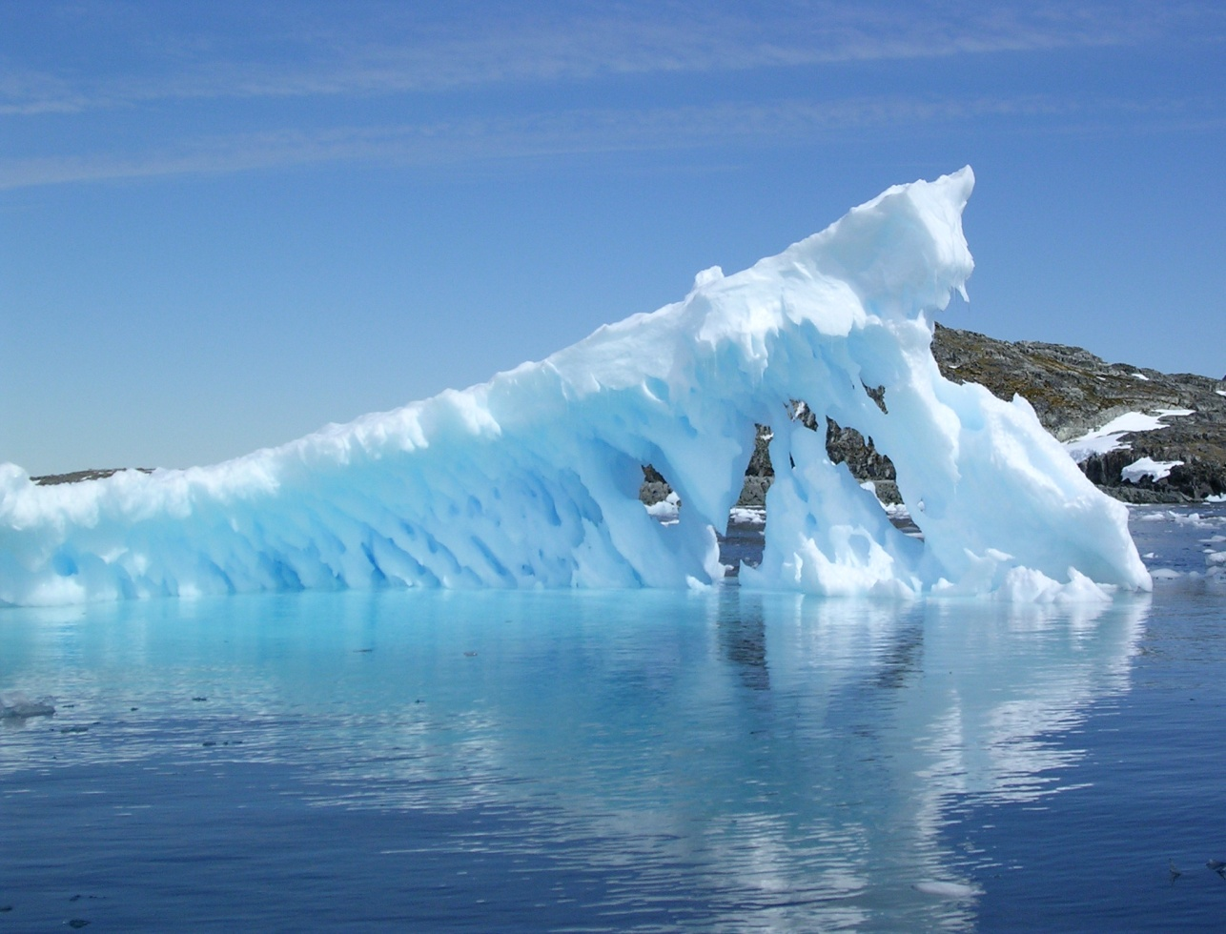
Glacier Bay
This glacier is in the warmest place on earth that I know of .

Slide 5
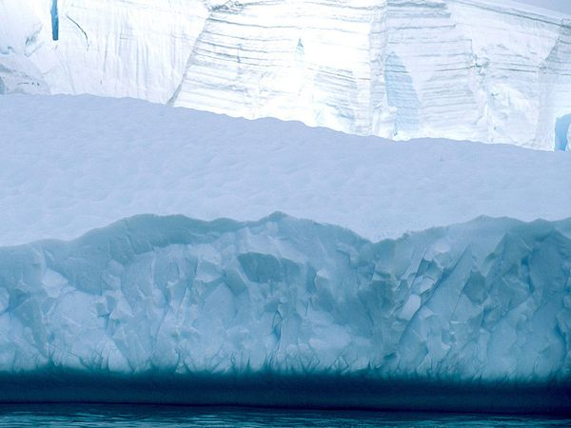
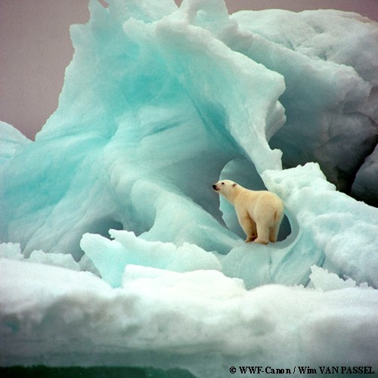
This is a male polar bear

