Slide 1
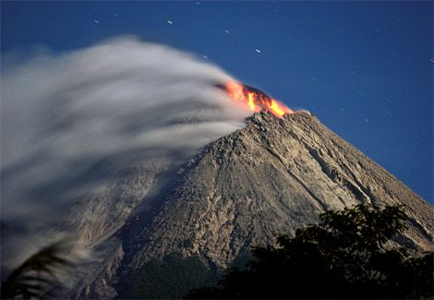
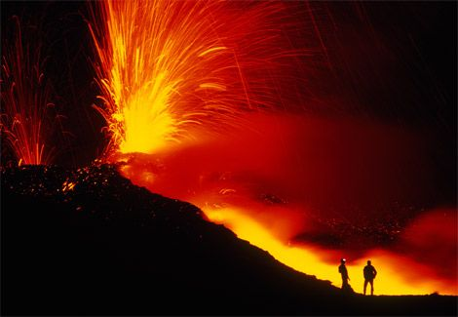
volcanoes
Marissa, Brianna, Rosabra

Slide 2
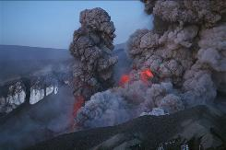
Facts of volcanoes
The volcano has been exploding for several days, causing Mexico’s national center for disaster prevention to elevate their national alert rating to yellow phase 3.A yellow alert signals that the volcano has demonstrated medium-to-high levels of activity. Posted 5/26/2010 7:51 pm updated 5/26/2010 9:52 pm.

Slide 3
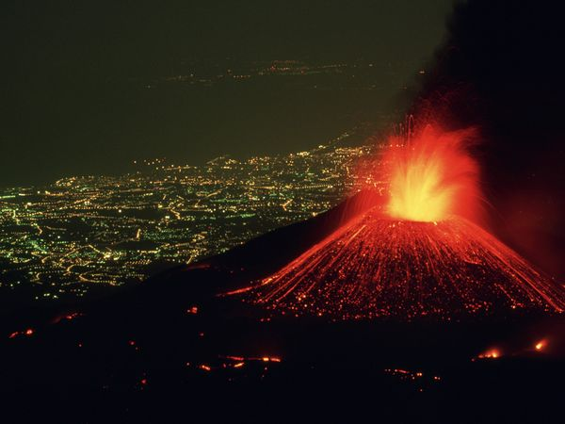
Volcano PICTURES

Slide 4
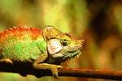
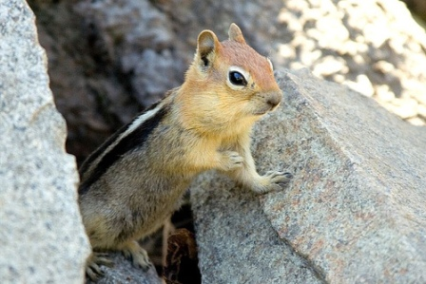
Animals that live around the volcanoes
The golden-mantled ground squirrel is often a chipmunk.
A colorful iguana.

Slide 5
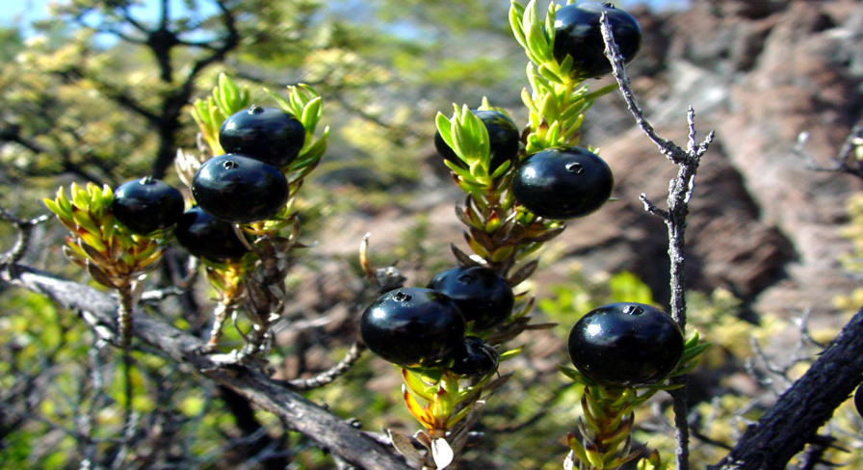
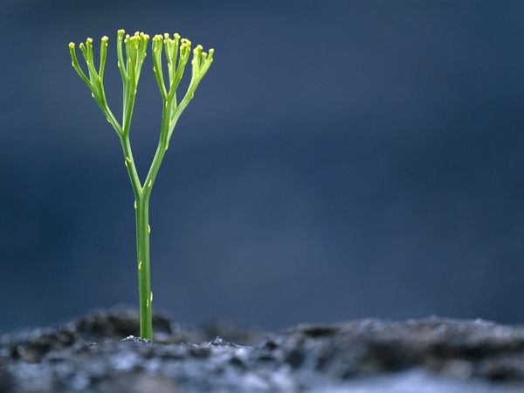
Plants that live around volcanoes
Lava makes ferns grow and it make black-berries look so shiny and tasty!

Slide 6
Like and dislike
dislikes
The volcano explodes.
The volcano ruins people lives.
likes
The lights from the volcanoes makes the sky different colors.
The volcanoes help the plants grow.

