Slide 1
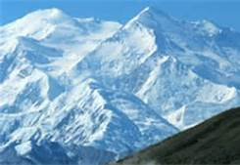
Glacier
By: Marimar and Arturo

Slide 2
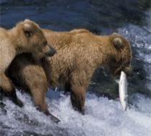
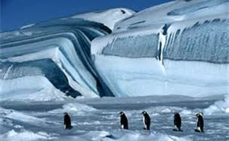
Animals that live in Glacier: penguin are one of the animal that live in glacier. They walk in the cold snow. Brown bear hunt for fish in the cold water.

Slide 3
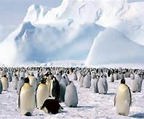
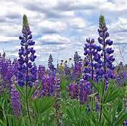
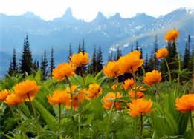
Plant
Plants that live in Glacier
This plant is a purple wild flower that live in glacier. The global warming
Is a flower that is yellow. The global warming is a soft plant in it has a
Green stem.

Slide 4
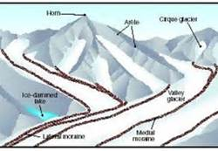
How is glacier form
Glacier begins to form when snow remains in the same area year, where enough snow accumulates to transform into ice. Like this.

Slide 5
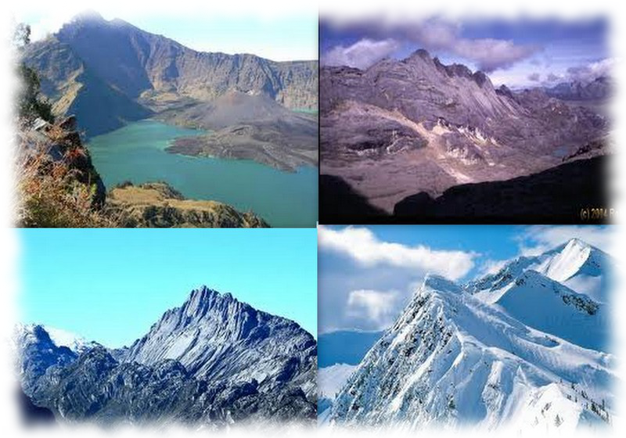
n
A FAMOUS PICTURE OF HOW IS GLACIER FORM

Slide 6
How we enjoy the project
We enjoy the project because we copy the pictures on the slid. We found some cool pictures in we copy the picture.

